Slide 1
Introduction to C++
Dr. Alex Hill
a.d.hill@liverpool.ac.uk
October 2022

Slide 2
Last week…
Passing vectors into functions (pointers)
Saving data
Plotting data with Python

Slide 3
AIM of workshop Four
Homework recap
Classes in C++
Monte Carlo and Markov Chains

Slide 4
Resources
alex-hill94.github.io/#WS4
https://www.w3schools.com/cpp/cpp_classes.asp
https://library.lanl.gov/cgi-bin/getfile?00326866.pdf

Slide 5
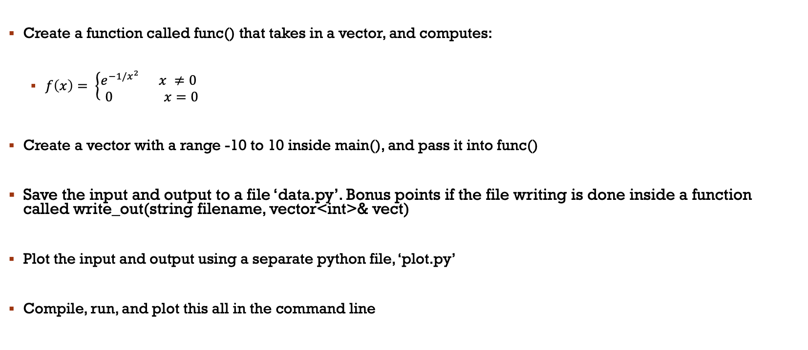
Challenge six RECAP
Create a function called func() that takes in a vector, and computes:
$f\left(x\right)= \left\{\begin{aligned}e^{−1/x^{2}} x ≠0 \\ 0 x=0\end{aligned} \right.$
Create a vector with a range -10 to 10 inside main(), and pass it into func()
Save the input and output to a file ‘data.py’. Bonus points if the file writing is done inside a function called write_out(string filename, vector<int>& vect)
Plot the input and output using a separate python file, ‘plot.py’
Compile, run, and plot this all in the command line

Slide 6
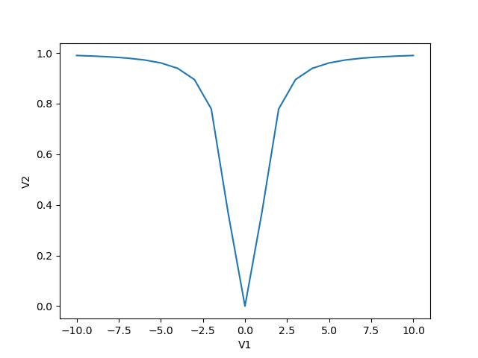
Challenge six solution: Lauryn
#include <iostream>
#include <cmath>
#include <vector>
#include <fstream>
using namespace std;
void func(vector<double>& v1, vector<double>& v2){;
int i;
for (i = 0; i < v1.size(); i++){
if(v1[i] != 0){
v2.push_back(exp(-(1/((pow(v1[i],2))))));
}
else {
v2.push_back(0);
}
}
}
int main (){
fstream myfile;
myfile.open("data.py", std::ios::out);
myfile << "import numpy as np" << "\n";
myfile << "\n";
myfile << "v2 = np.array((";
vector<double> v1 = {-10,-9,-8,-7,-6,-5,-4,-3,-2,-1,0,1,2,3,4,5,6,7,8,9,10};
vector<double> v2 = {};
func(v1,v2);
for (int i = 0; i < v2.size(); i++){
if (i < (v2.size()-1)){
myfile << v2[i] << ",";
}
else{
myfile << v2[i];
}
}
myfile << "))" << endl;
myfile << "\n";
myfile << "v1 = np.array((";
for (int j = 0; j < v1.size(); j++){
if (j < (v1.size()-1)){
myfile << v1[j] << ",";
}
else{
myfile << v1[j];
}
}
myfile << "))" << endl;
myfile.close();
return 0;
}
Could use a ‘const’ here to make sure v1 isn’t changed accidentally
Ok to do this for short arrays, but what if we wanted 1e6 points?

Slide 7
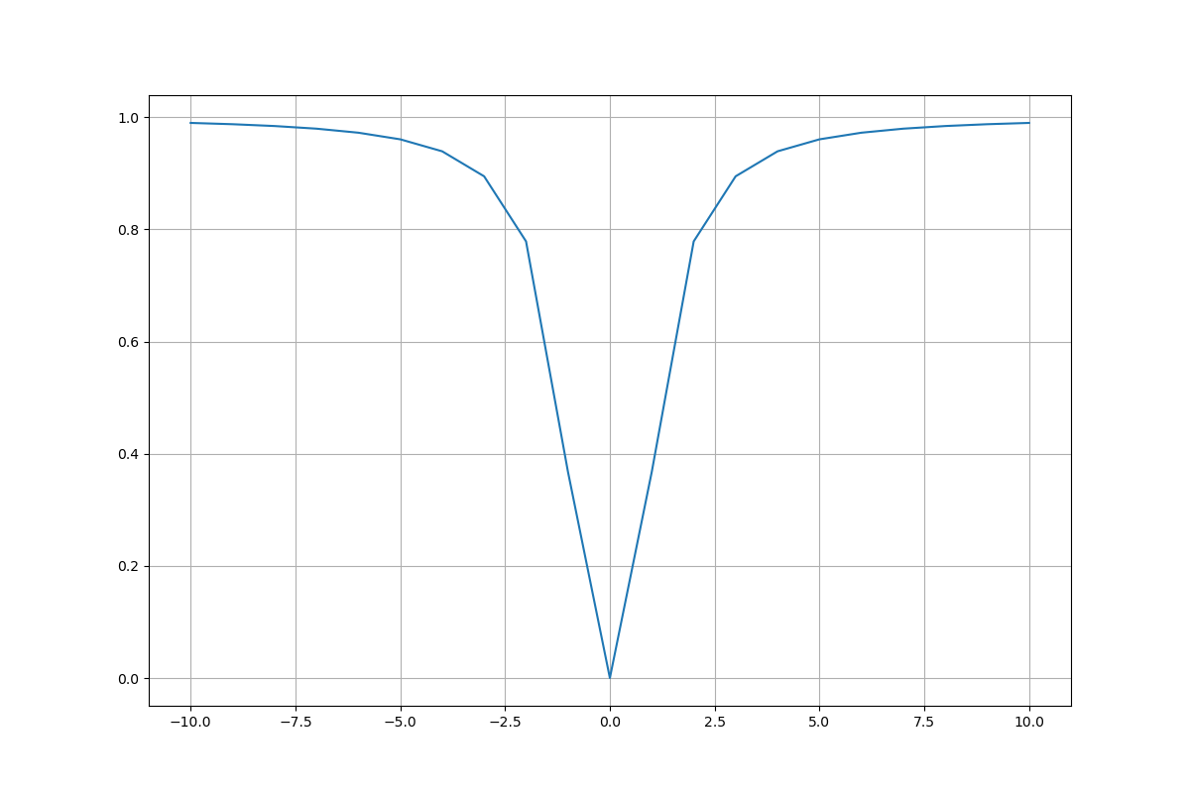
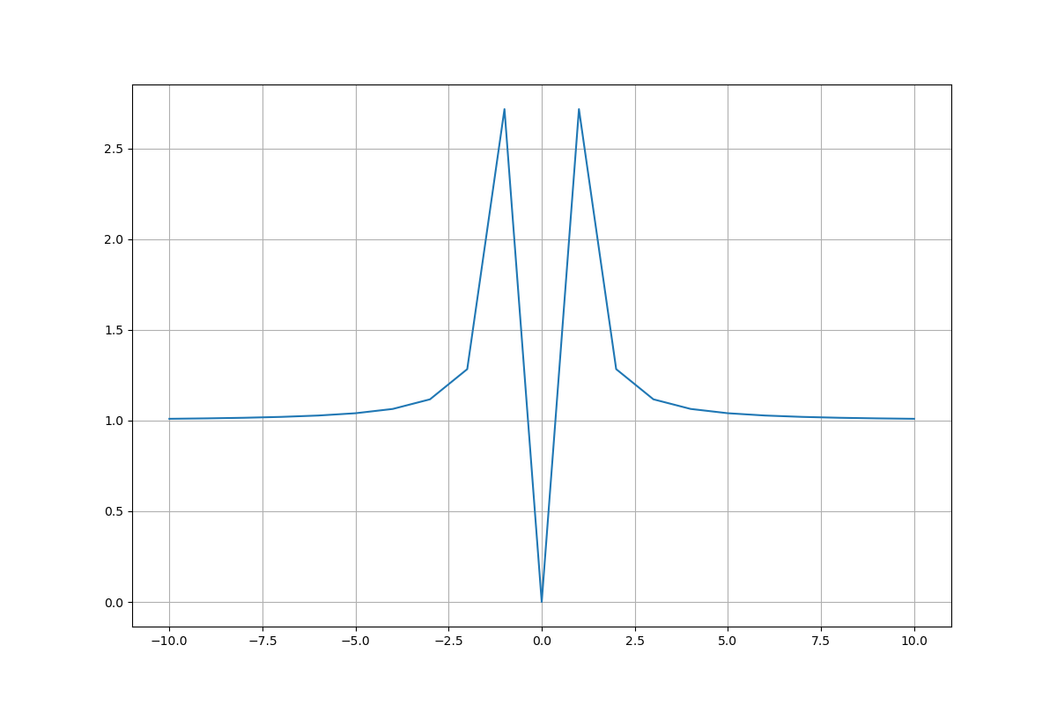
Challenge six solution: Tom
Takes a copy of x, for large arrays this will use a lot of memory
void write_out(vector<double> x, vector<double>& f_x)
{
const string filename = "data_file.py";
ofstream myfile;
myfile.open(filename.c_str());
myfile << "import numpy as np\n\nx = np.array((";
for (double i:x)
{
if(i != x.back())
{
myfile << i << ",\n";
}
else{myfile << i << "\n";}
}
bool first = 1;
myfile << "))\n";
myfile << "f_x = np.array((" << "\n";
for (double j:f_x)
{
if((j != f_x.back()) || first == 1)
{
myfile << j << ",\n";
first = 0; // I had to add this little boolean workaround
// because the first and last j values are the same, so the
// first f_x file input was missing a comma afterwards.
}
else{myfile << j << "\n";}
}
myfile << "))\n";
myfile.close();
}
#include <iostream>
#include <fstream>
#include <vector>
#include <cmath>
using namespace std;
void write_out(vector<double> x, vector<double>& f_x);
void func(vector<double> x, vector<double>& f_x);
int main()
{
vector<double> x = {-10, -9, -8, -7, -6, -5, -4, -3, -2, -1, 0, 1, 2, 3, 4, 5, 6, 7, 8, 9, 10};
vector<double> f_x;
func(x, f_x);
write_out(x, f_x);
return 0;
}
void func(vector<double> x, vector<double>& f_x)
{
for(double i:x)
{
if(i != 0){f_x.push_back(exp((1/pow(i, 2))));}
else{f_x.push_back(0);}
}
}
Cool workaround of this problem
I like how short main() is!
Needs a -1!

Slide 8
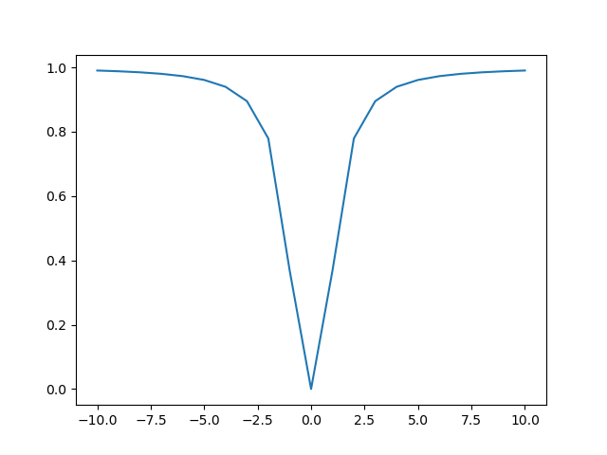
Challenge six Solution: ryan
void func(vector<float>& vect){
for(int i = 0; i < 21; i++){
if (vect[i] != 0){
double x = 0;
x = -(1/(pow(vect[i], 2)));
vect[i] = pow(M_E, x);
}}}
int main(){
// initialise the vector and fill it from -10 to 10
vector<float> vect;
for(int i = 0; i < 21; i++){
vect.push_back(i-10) } }
// have func operate on the vector and output it in the terminal
func(vect);
cout << setprecision(5);
for(int i = 0; i < vect.size(); i++){
cout << vect[i] << ", ";}
// create the plot.py routine for plotting the graph
ofstream fileaccess("plot.py");
fileaccess << "import matplotlib.pyplot as plt" << "\n";
fileaccess << "from data import *" << "\n" << "import numpy as np" << "\n" << "\n";
fileaccess << "x = np.array([-10, -9, -8, -7, -6, -5, -4, -3, -2, -1, 0, 1, 2, 3, 4, 5, 6, 7, 8, 9, 10])" << "\n" << "\n";
fileaccess << "plt.figure()" << "\n" << "plt.plot(x, y)" << "\n" << "plt.show()";
fileaccess.close();
// feed the file name and vector into the writeout function
writeout("data.py", vect);
return 0;}
Works fine, but tricky to adapt

Slide 9
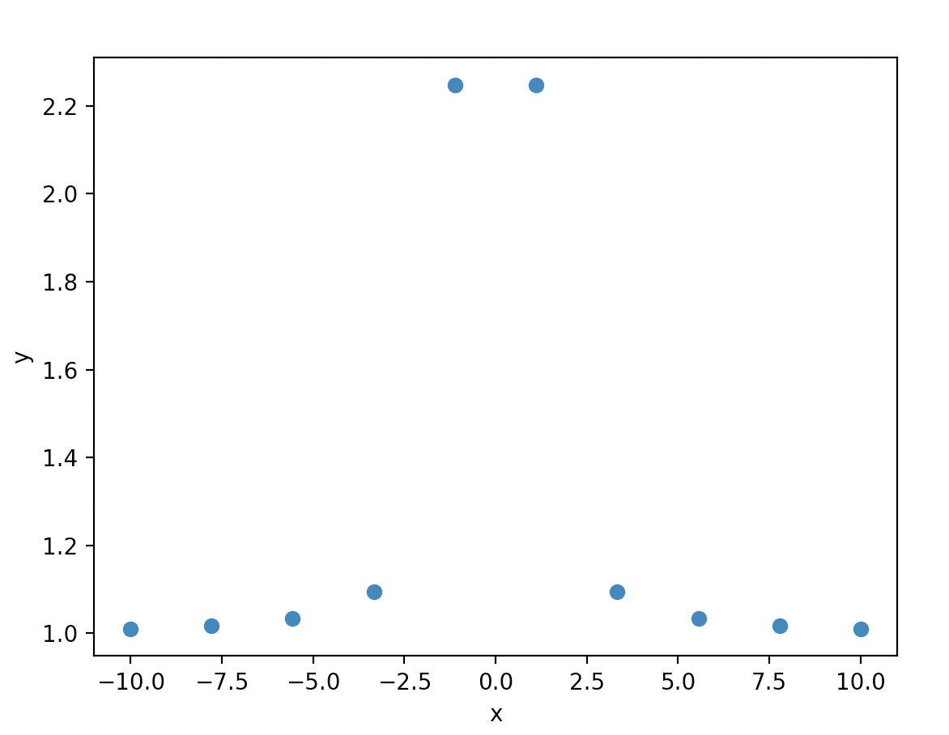
Challenge six solution: andrea
void plot(std::string filename){
std::ofstream python_file;
python_file.open("plot.py");
python_file<<
"import matplotlib.pyplot as plt\n"<<
"import numpy as np\n"<<
"from data import *\n"
"plt.scatter(x,y, 'r*')\n"<<
"plt.xlabel('x')\n"<<
"plt.ylabel('y')\n"<<
"plt.savefig('plot.png', dpi=400)\n"<<
"plt.show()";
python_file.close();
}
Nice idea to writing of a python script in C++
Note: you can also run terminal commands in a C++ script using:
system() for example
system(”python plot.py");
Script didn’t run right away, need to import numpy as np in data.py

Slide 10
Challenge six solution: Alex j
No const, so vectors could in theory be changed by this function
void write_out(string filename,vector<double>&vect1,vector<double>&vect2){
// write out takes a filename and two vectors and writes out the vectors to the script as nupy arrays and python code that
// when run will plot the second vector aginst the first
ofstream MyFile("data.py");
MyFile << "import numpy as np" << endl << endl;
MyFile << "x = np.array((" << endl;
for(int i=0;i<vect1.size()-1;i++){
MyFile << vect1.at(i) << ", " << endl;}
MyFile << vect1.back() << endl;
MyFile << "))"<< "\n" << "\n";
MyFile << "y = np.array((" << "\n";
for(int i=0;i<vect2.size()-1;i++){
MyFile << vect2.at(i) << ", " << endl;}
MyFile << vect2.back() << endl;
MyFile << "))"<< endl << endl;
MyFile.close();}
Loop to n-1 to avoid comma issue
(base) alexhill at Alexs-Air in ~/Documents/UOL/Teaching/C++_Workshops/Workshops/WS4/Homework/a_jury
$ g++ -std=c++11 -o soln soln.cpp
(base) alexhill at Alexs-Air in ~/Documents/UOL/Teaching/C++_Workshops/Workshops/WS4/Homework/a_jury
$ ./soln

Slide 11
Challenge six solution: Alex j
void plot(string filename){
// plot to be run after write out and using the same file name
// will run file name Warning! only for use of unix based systems
string comando="python3 ./";
comando+=filename;
system(comando.c_str());
}
int main(){
// Create an empty vector
vector<double> input;
for(double i=-10;i<=10;i++){
input.push_back(i);
}
vector<double> output(input.size());
func(input,output);
write_out("data.py",input,output);
ofstream PlotFile("plot.py");
PlotFile << "import matplotlib.pyplot as plt" << endl << "from data import *" << endl<< "plt.figure()"<<endl <<"plt.plot(x, y)"<< endl <<"plt.show()";
PlotFile.close();
plot("plot.py"); // only for use on linux
return 0;
}
Runs python command inside C++ script
Concise
(base) alexhill at Alexs-Air in ~/Documents/UOL/Teaching/C++_Workshops/Workshops/WS4/Homework/a_jury
$ g++ -std=c++11 -o soln soln.cpp
(base) alexhill at Alexs-Air in ~/Documents/UOL/Teaching/C++_Workshops/Workshops/WS4/Homework/a_jury
$ ./soln

Slide 12
Challenge six Solution: Alex h modular approach
#include <cmath>
#include <iostream>
#include <vector>
#include <fstream>
using namespace std;
void f_x(const double& x, double& fx)
{some stuff} void f_master(const vector<double>& input, vector<double>& output)
{some stuff} void write_out_vec(const string& filename, string& array_name , const vector<double>& output)
{some stuff} int main()
{some stuff}

Slide 13
Challenge six Solution: alex h
void f_x(const double& x, double& fx)
{
if (x == 0)
{
fx = 0;
}
else
{
fx = exp(-1/pow(x,2));
}
}
void f_master(const vector<double>& input, vector<double>& output)
{
double temp_val;
for (auto i: input){
f_x(i, temp_val);
output.push_back(temp_val);
}
}
Fix the vector input
Create a temporary variable
temp_val is changed by f_x
Add new temp val to output vector

Slide 14
Challenge six Solution: alex h
int main()
{
string filename = "data1.py";
double k;
cout << "n_vals = ?";
cin >> k;
double llim = -10;
double ulim = 10;
double seps = (ulim - llim)/(k - 1);
vector<double> x_range(k);
vector<double> fx_range;
for (int i =0; i < k; ++i)
{
x_range.at(i) = llim + (seps * i);
}
f_master(x_range, fx_range);
string x_lab = "x_range";
string fx_lab = "fx_range";
write_out_vec(filename, x_lab , x_range);
write_out_vec(filename, fx_lab , fx_range);
return 0;
}
Create input data
Compute function
Write vectors to file

Slide 15
Challenge six Solution: alex h
void write_out_vec(const string& filename, string& array_name , const vector<double>& output, bool initialise = true)
// Writes out data in numpy form. If initialise == true, creates file from scratch and includes top lines needed
{
ofstream myfile;
if (initialise){
myfile.open (filename);
myfile << "import numpy as np" << "\n" << "\n";}
else{myfile.open (filename, std::ios_base::app);}
myfile << array_name << " = np.array((" << "\n";
for (auto i = 0; i < output.size(); ++i)
{if (i != (output.size() - 1))
{myfile << output.at(i) << ", " << "\n";}
else
{myfile << output.at(i) << "\n";}}
myfile << "))" << "\n"; myfile.close();}
Opens data file without wiping what’s already there
Loops over vector and writes out. If not at the end, then include comma

Slide 16
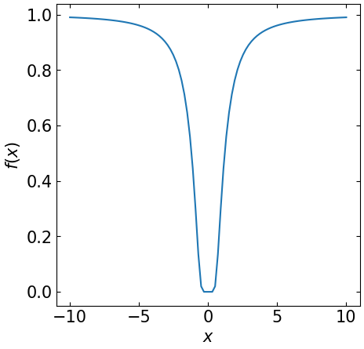
Challenge six Solution: alex h
import matplotlib
import matplotlib.pyplot as plt
from data1 import *
FS = 15
matplotlib.rcParams.update({'font.size': FS})
fig, axs = plt.subplots(1,1, figsize = [5,5])
axs.plot(x_range, fx_range)
axs.set_xlabel('$x$')
axs.set_ylabel('$f(x)$')
axs.xaxis.set_tick_params(direction= 'in', which='both', right =True, top = True)
axs.yaxis.set_tick_params(direction= 'in', which='both', right =True, top = True)
plt.savefig('test.png',bbox_inches = 'tight', pad_inches = 0.05)

Slide 17
Takeaways
Try to make your code easily adaptable
Fix the values of your vectors using const to ensure no mistakes
Try writing python inside a C++ script!

Slide 18
Challenge seven
Aim: compute x^2 + 4x – 10 for an arbitrary input, save input/output data, plot the results
In main():
Create an input vector x = (start, ….., end) with len(x) = k
Set start = -100, end = 100, k = 1e6 initially
Create a blank vector called output
Pass input and output to a function func
Pass input/output to a function called write_out
In func():
Import memory addresses for input/output, i.e. don’t create copies
Fix input, allow output to change
Modify output according to x^2 + 4x – 10
In write_out():
Save data to a named python script data.py
Python script:
Load in data, plot results (you can do this inside a C++ function if you like)

Slide 19

classes
Basics of Classes in C++
Attributes and Methods
Constructors
Access specifiers

Slide 20
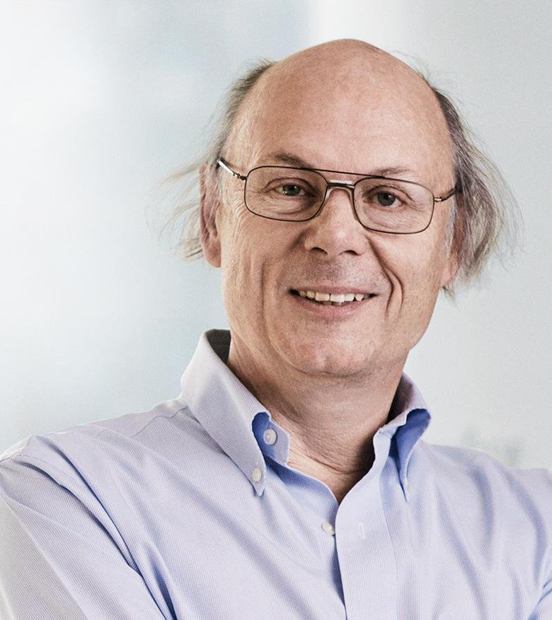
Object oriented programming
Procedural programming writes functions to perform operations on data
OOP creates objects that contain both data and functions
Why? DRY! (Don’t repeat yourself)

Slide 21


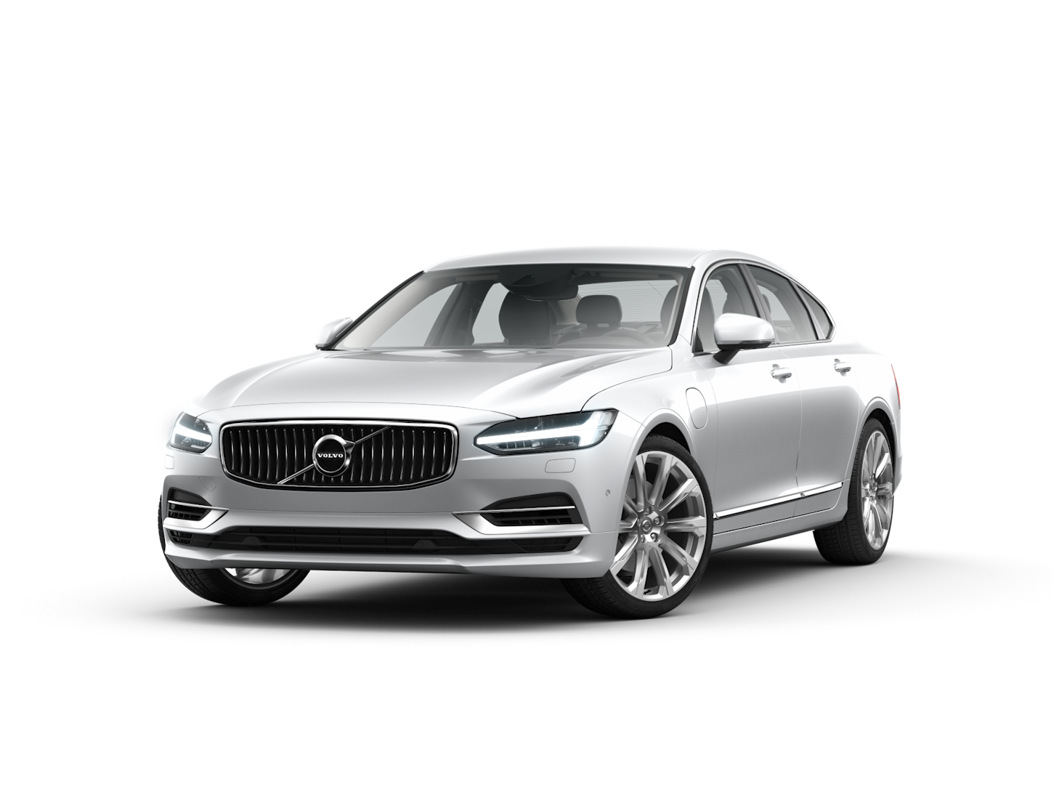
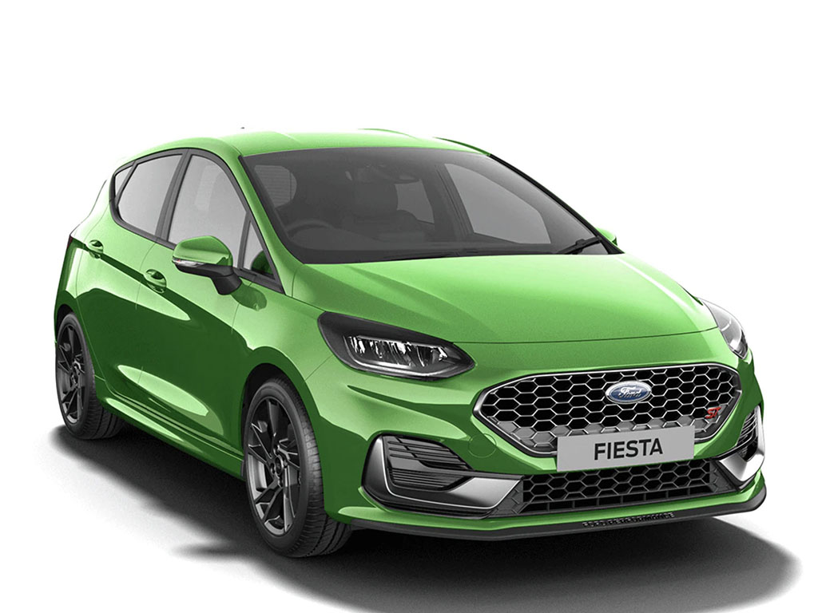
Classes and objects
A ‘Class’ is a template for an ‘Object’
An ‘Object’ is an instance of a Class
E.g. for the ’Car’ class, you may have ‘Volvo’, ‘Audi’ and ‘Ford’ objects

Slide 22
Classes and objects
Classes have attributes (variables, e.g. weight, colour)
Classes have methods (functions, e.g. brake, open door)
Attributes and functions are referred to as class members
Attributes
Methods

Slide 23
Classes: attributes
Creates a class called Car
Determines how visible innards of class is to the outside
#include <iostream>
using namespace std;
class Car { // The class
public: // Access specifier
int n_seats; // Attribute (int variable)
string brand; // Attribute (string variable)
string model; // Attribute (string variable)
};
int main() {
Car newcar; // Create an object of Car
// Access attributes and set values
newcar.n_seats = 5;
newcar.brand = "Seat";
newcar.model = "Ibiza";
// Print attribute values
cout << newcar.n_seats << "\n";
cout << newcar.brand << "\n";
cout << newcar.model << "\n";
return 0;
}
Creates some attributes
Creates object called newcar via the car class
Changes values of class attributes

Slide 24
Classes: Attributes
int main() {
Car peoplecarrier; // Create an object of Car
Car sportscar; // Create an object of Car
// Access attributes and set values
peoplecarrier.n_seats = 7;
sportscar.n_seats = 2;
return 0;
}
You can create multiple objects of a given class

Slide 25
Classes: methods
Creates a function inside the class
#include <iostream>
using namespace std;
class Car {
public:
void Beep() {
cout << "Beep Beep" << endl;
};
int speed(int maxSpeed);
};
int Car::speed(int maxSpeed) {
return maxSpeed;
}
int main() {
Car myObj; // Create an object of Car
myObj.Beep();
cout << myObj.speed(200); // Call the method with an argument
return 0;
}
Declare a function inside the class
Define the function outside outside the function
Scope resolution operator ‘::’

Slide 26
Constructors
Constructor is called with the class name
Pass arguments to constructors when objects are created
#include <iostream>
using namespace std;
class Car { // The class
public: // Access specifier
string brand; // Attribute
Car(string x) { // Constructor with parameters
brand = x;
}
};
int main() {
// Create Car objects and call the constructor with different values
Car carObj1("BMW");
Car carObj2("Ford");
// Print values
cout << carObj1.brand << "\n";
cout << carObj2.brand << "\n";
return 0;
}
Constructors are special functions that are called whenever an object is created
Constructors can take arguments, e.g. to initialise the values of certain attributes
You can also define constructors outside of a class

Slide 27
Challenge eight
Create a class called Country with attributes:
Population, size, national language
Include a method called Greet, which outputs “Hello!”
In main(), create objects from the country class called: UK, France, Spain
Use constructors to initialise the attributes mentioned above
Print all attributes and run Greet
Bonus: inside Greet include an ‘if’ statement that changes language based on the national language

Slide 28
Principles of OOP
Encapsulation
Inheritance
Polymorphism

Slide 29
Access specifiers
class Car {
public:
void Beep() {
cout << "Beep Beep" << endl;
}
Access specifiers can be:
Private: members cannot be viewed outside the class
Public: members are accessible outside the class
Protected: members cannot be accessed outside the class, however they can be accessed in inherited classes
By default, classes are private

Slide 30
Access specifiers
#include <iostream>
using namespace std;
class MyClass {
public: // Public access specifier
int x; // Public attribute
private: // Private access specifier
int y; // Private attribute
};
int main() {
MyClass myObj;
myObj.x = 25; // Allowed (public)
myObj.y = 50; // Not allowed (private)
return 0;
}
$ g++ -std=c++11 -o soln lesson_ex.cpp
lesson_ex.cpp:14:9: error: 'y' is a private member of 'MyClass'
myObj.y = 50; // Not allowed (private)
^

Slide 31
Encapsulation
Encapsulation ensures that code and data are in a black box (if desired)
You can use the ‘private’ access specifier to ensure this
It’s often the practice to use functions to retrieve (get) and define (set) attributes
Code
Data

Slide 32
Encapsulation
#include <iostream>
using namespace std;
class Employee {
private:
int salary;
public:
void setSalary(int s) {
salary = s;
}
int getSalary() {
return salary;}};
int main() {
Employee myObj;
myObj.setSalary(50000);
cout << myObj.getSalary();
return 0;}
(base) alexhill at Alexs-Air in ~/Documents/UOL/Teaching/C++_Workshops/Workshops/WS4/Scripts
$ ./soln
50000

Slide 33
inheritance
#include <iostream>
using namespace std;
// Base class
class Vehicle {
public:
string brand = "Ford";
void honk() {
cout << "Tuut, tuut! \n" ;}};
// Derived class
class Car: public Vehicle {
public:
string model = "Mustang";};
int main() {
Car myCar;
myCar.honk();
cout << myCar.brand + " " + myCar.model;
return 0;}
You can have multilevel inheritance (Grandparent -> Parent -> Child)
Derived class inherits from parent class using ‘:’ symbol
You can also have multiple inheritance, i.e.:
class MyChildClass: public MyClass, public MyOtherClass
$ ./soln
Tuut, tuut!
Ford Mustang

Slide 34
Inheritance: access specifiers
// Base class
class Employee {
protected: // Protected access specifier
int salary;
};
// Derived class
class Programmer: public Employee {
public:
int bonus;
void setSalary(int s) {
salary = s;
}
int getSalary() {
return salary;
}
}
‘Protected’ data can be accessed by the inherited class

Slide 35
polymorphism
Polymorphism allows us to use inherited methods to perform different tasks
#include <iostream>
using namespace std;
// Base class
class Animal {
public:
void animalSound() {
cout << "The animal makes a sound \n";
}
};
// Derived class
class Pig : public Animal {
public:
void animalSound() {
cout << "The pig says: weeee\n";
}
};
// Derived class
class Dog : public Animal {
public:
void animalSound() {
cout << "The dog says: woof \n";
}
};
int main() {
Animal myAnimal;
Pig myPig;
Dog myDog;
myAnimal.animalSound();
myPig.animalSound();
myDog.animalSound();
return 0;
}
$ ./soln
The animal makes a sound
The pig says: weee
The dog says: woof

Slide 36
Monte carlo methods
History, general concepts
Quick example
Other examples
Markov Chains

Slide 37
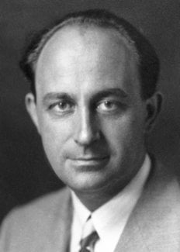
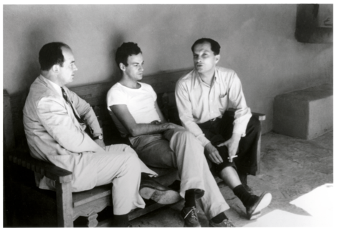
Monte carlo history
Enrico Fermi
John von Neumann
Stanislaw Ulam
The Monte Carlo Method is a mathematical technique used to estimate the outcomes of an uncertain event
Developed during WWII in relation to the Manhattan project
Named after the Monte Carlo Casino, frequented by Ulam’s uncle, as chance is important to the modelling approach
Idea: use random sampling of inputs to explore outputs complex systems

Slide 38

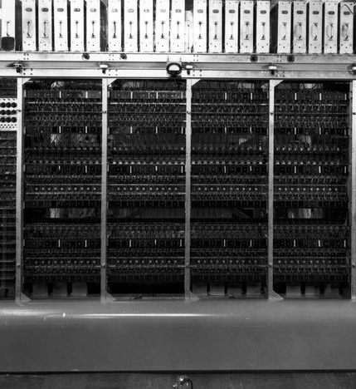

Monte carlo history
The challenge of constructing the atom bomb involved neutron diffusion
Too challenging to be addressed analytically, needed a numerical approach
Some of the first computers tried an exhaustive numerical approach (plug in many numbers into the eqn and calc the result), but this was too slow due to high dimensionality of the problem
Monte Carlo methods were found to be remarkably successful
MANIAC Computer

Slide 39

Monte carlo experiments
Generate random inputs according to some distribution
Use these to conduct an experiment
Analyse the output using statistics and make predictions of the simulation’s properties

Slide 40
Monte carlo simulations now
Building models to predict outcomes of simulations/processes given uncertain inputs
Example: roll two dice to predict probability of getting a given number in total

Slide 41

Monte Carlo examples
Business applications:
Estimate probability of cost overrun in large projects
Estimate likelihood of an asset gaining/losing value
Path tracing in video games (trace random samples of possible light paths)
AI for video games (tree search for next best move)
Computational physics, physical chemistry
E.g. Monte Carlo molecular modelling: generate states according to a Boltzmann distribution

Slide 42

Generating random numbers in c++
We’ll use the <random> header to generate random numbers (https://cplusplus.com/reference/random/)
This uses Generators and Distributions to generate random numbers
Generator: an object that generates uniformly distributed numbers
Distribution: an object that transforms sequences of numbers generated by a generator into sequences of numbers that follow a specific random variable distribution

Slide 43
Generating random numbers in c++
Mersenne twister random number engine
Start and end points
#include <iostream>
#include <vector>
#include <random>
using namespace std;
int main(){
const int range_from = 0;
const int range_to = 1000;
random_device rand_dev;
mt19937 generator(rand_dev());
uniform_int_distribution<int> distr(range_from, range_to);
cout << distr(generator) << '\n';
return 0;
}
random_device: creates non-deterministic random numbers
Uniform integer distribution
Define distribution
Distribution takes Generator as argument to produce random number

Slide 44
Example
#include <iostream>
#include <vector>
#include <random>
#include <cmath>
#include <fstream>
#include "funcs.h"
using namespace std;
int main(){
int n_sim_runs = 1e5;
vector<double> inputs(n_sim_runs);
vector<double> outputs;
string fname = "data.py";
string xname = "x_range";
string yname = ”y_range";
for (auto i = 0; i < inputs.size(); ++i){
rnum(inputs.at(i));
}
simulation(inputs, outputs);
write_out_vec(fname, xname, inputs);
write_out_vec(fname, yname, outputs, false);
system("ipython test.py &");
return 0;
}
Some auxiliary functions I’ve made
Create inputs with length ‘n’
A ‘simulation’ takes one input (uniform dist.) and produces one output
What is the output distribution?
Blank outputs
Replaces inputs elements with random numbers
Runs ‘simulation’, outputs is now the simulation’s output
Writes out data
Runs plotting python script

Slide 45
Example
void rnum(double& input){
const double range_from = -1000;
const double range_to = 1000;
random_device rand_dev;
mt19937 gen(rand_dev());
uniform_real_distribution<double> distr(range_from, range_to);
input = distr(gen);
}
Random number function takes an element the the input vector, and makes it a random float between -1000 and 1000

Slide 46
Example
Input is fixed, output can change
void buffer(const double& input, double& output){
// Computes a polynomial from a given input, modifies the output accordingly
output = pow(input, 3) - 3*pow(input, 2) + 9.2 * pow(input,1) + 4.3;
}
void simulation(const vector<double>& input, vector<double>& output)
{
// Simulation loops over inputs and modifies the output vector
double temp_val;
for (auto i: input){
buffer(i, temp_val);
output.push_back(temp_val);
}
}

Slide 47
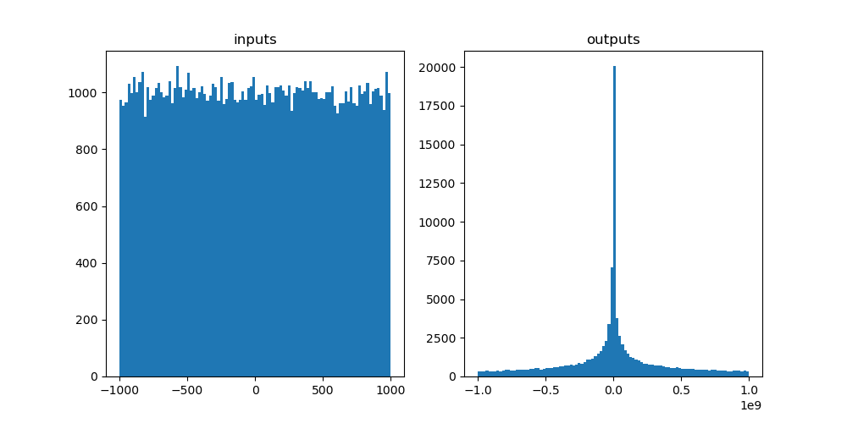
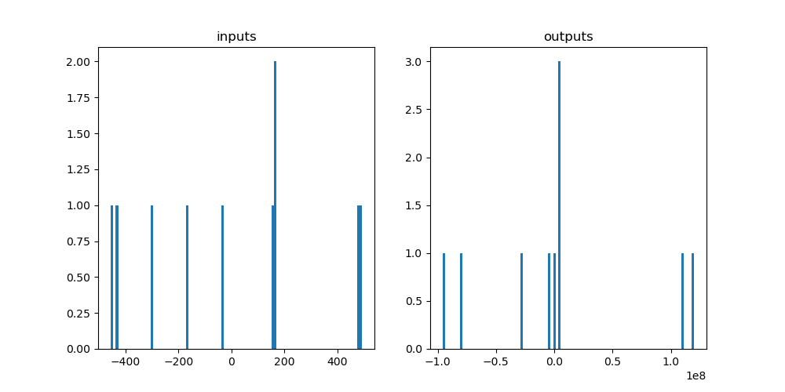
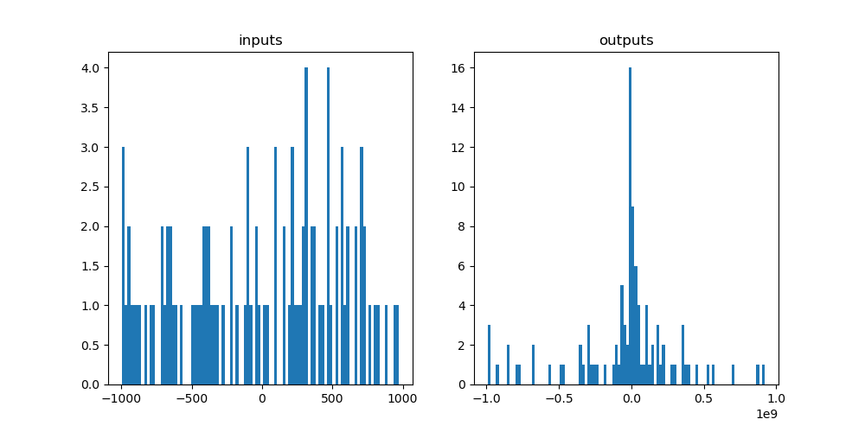
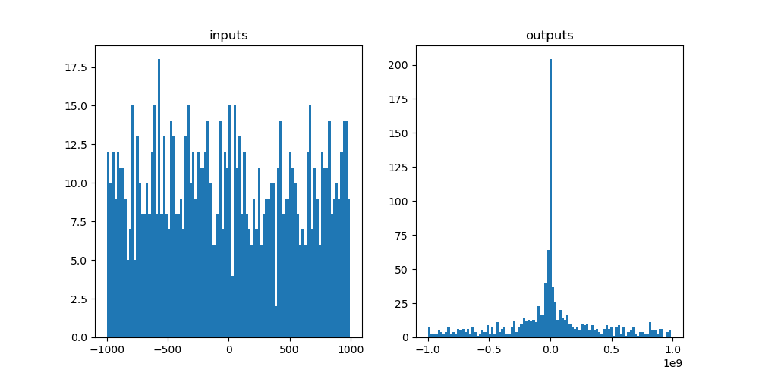
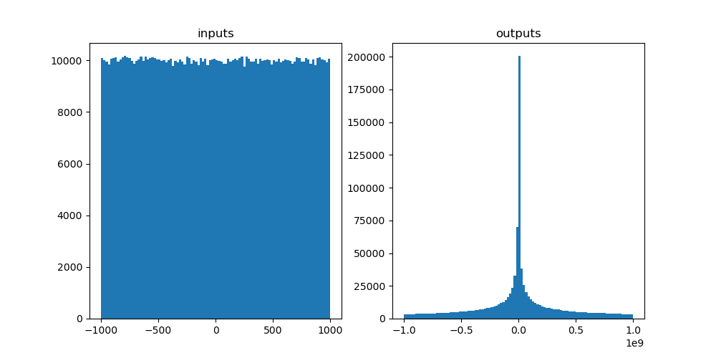
Example
1e1 -> 1e6 draws

Slide 48
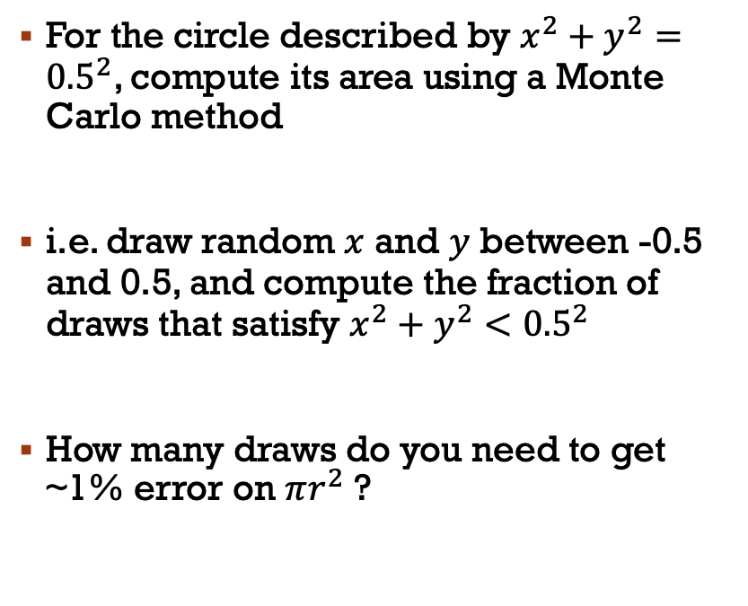
Challenge nine: Area of a circle
0.5
For the circle described by $x^{2}+y^{2}={0.5}^{2}$, compute its area using a Monte Carlo method
i.e. draw random $x$ and $y$ between -0.5 and 0.5, and compute the fraction of draws that satisfy $x^{2}+y^{2}<{0.5}^{2}$
How many draws do you need to get ~1% error on $πr^{2}$ ?
-0.5
0.5
-0.5

Slide 49
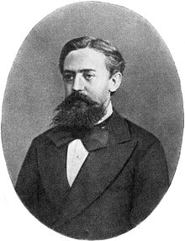
Markov chain monte carlo (MCMC)
Monte Carlo: estimate the expected value or probability density of some unknown space by drawing independent random values
For high-dimension probabilistic models, Monte Carlo sampling may not be effective, as volume of sample space grows exponentially with additional parameters
MCMCs try to sample more intelligently, the next random draw depends on the current one
Andrey Markov

Slide 50
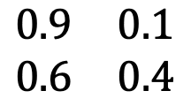
Markov chains
0.9
Attend
A simple Markov Chain uses stochastic processes to determine the evolving state of a system
Consider this system, it describes whether someone attends class given their previous attendance
E.g. if you attend class one week, there’s a 90% chance you will the next
0.1
0.6
Skip
0.4
TO
attend
skip
attend
$$\begin{matrix}0.9 & 0.1 \\ 0.6 & 0.4\end{matrix}$$
FROM
skip
Transition matrix

Slide 51
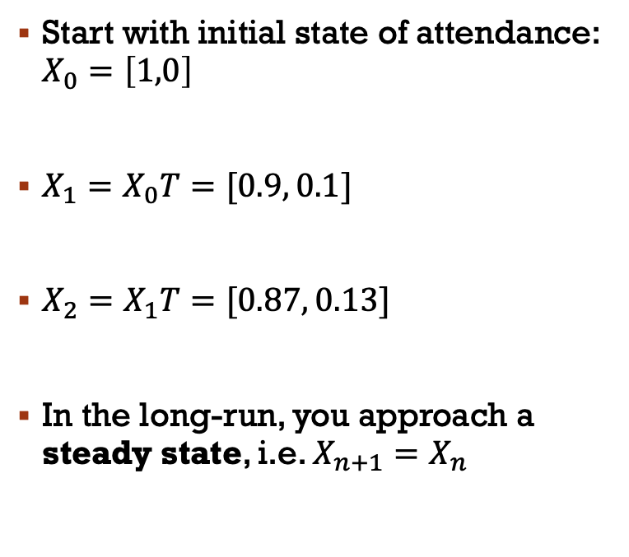
Markov chain properties
0.9
Attend
Start with initial state of attendance: $X_{0}=\left[1,0\right]$
$X_{1}=X_{0}T=[0.9, 0.1]$
$X_{2}=X_{1}T=[0.87, 0.13]$
In the long-run, you approach a steady state, i.e. $X_{n+1}=X_{n}$
0.1
0.6
Skip
0.4
TO
attend
skip
attend
$$\begin{matrix}0.9 & 0.1 \\ 0.6 & 0.4\end{matrix}$$
FROM
skip
Transition matrix

Slide 52
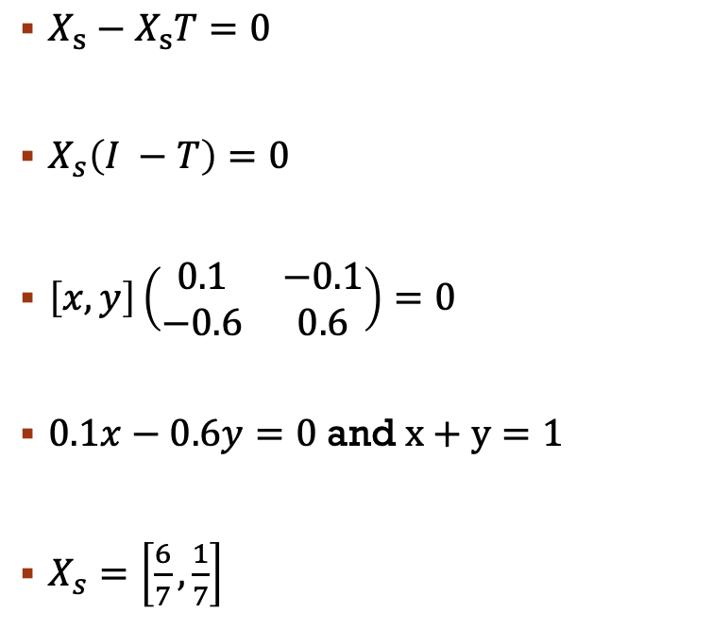
0.9
Markov chain properties
Attend
$X_{s}−X_{s}T=0$
$X_{s}\left(I −T\right)=0$
$\left[x, y\right]\left(\begin{matrix}0.1 & −0.1 \\ −0.6 & 0.6\end{matrix}\right)=0$
$0.1x−0.6y=0$ and $x+y=1$
$X_{s}=\left[\frac{6}{7},\frac{1}{7}\right]$
0.1
0.6
Skip
0.4
TO
attend
skip
attend
$$\begin{matrix}0.9 & 0.1 \\ 0.6 & 0.4\end{matrix}$$
FROM
skip
Transition matrix

Slide 53
Markov chains
Markov chains can also be used to generate a sequence of random variables where the current value is dependent on the value of the prior value
An example of this is a number line, where possible moves are -1 and 1 (chosen with equal probability)
MCMCs are Monte Carlo methods where a Markov chain is used to draw samples
The idea is that the chain will settle (find equilibrium) on the desired quantity we are inferring

Slide 54
homework
0.76
Create a class that generates random numbers from a uniform distribution
Create a Markov Chain class that predicts which US party will win the next election (lookup matrices, matrix mutlipliaction, if statements etc.)
Assume initially a Dem is in power X0 = [1,0], create a method in the MC class that calculates numerically the steady state vector, i.e. the probability that in a given year
Create another method that uses random draws from the random number class to stochastically predict who will be in power for each of the next 20 cycles
Create a figure showing how the holder of office changed over the 20 cycles
Democrat
0.24
0.35
Republican
0.65

Slide 55
Next week
Markov Chain Monte Carlo
Introduction to your group project

Slide 56
Thanks!

